Slide 1
How to Verify a Compiler
Gordon Stewart
Assistant Professor, EECS

Slide 2
What’s a Compiler?
Compiler: A piece of software that translates source programs (e.g., C, Java) to functionally equivalent target programs (e.g., x86, PPC, ARM).
int main
(void) { … }
Lexing
Parsing
Typechecking
IR Generation
IR Optimization
Target Code Generation
Compiler
Compilation Phases
push %ebp
%eax <- %ebp + 1

Slide 3
What’s a Verified Compiler?
Verified Compiler: A compiler accompanied by a mathematical proof of correctness, preferably checked by computer.
Proof!
int main
(void) { … }
Lexing
Parsing
Typechecking
IR Generation
IR Optimization
Target Code Generation
Verified
Compiler
YES
push %ebp
%eax <- %ebp + 1
Proof
Checker
YES
NO
https://coq.inria.fr

Slide 4
CompCert (http://compcert.inria.fr)
A verified optimizing compiler for C
Targeting x86, PPC, and ARM assembly
Developed by Xavier Leroy, Sandrine Blazy and colleagues at INRIA c. 2006 – present
YES

Slide 5
CompCert (http://compcert.inria.fr)
A verified optimizing compiler for C
Performance: ~gcc –O1
YES

Slide 6



Why Verify One?
Compilers are everywhere!

Slide 7
Why Verify One?
Linux
C = 2,558,100 lines
Assembly = 12,164 lines
Almost 99.5% C!
1 / (14*14) * 100 = ~0.5%
Credit: Dave August

Slide 8
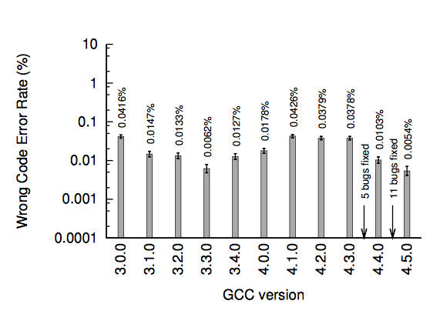
Why Verify One?
~1,000,000 test programs
Compilers have bugs
Finding and Understanding Bugs in C Compilers
[Yang,Chen,Eide,Regehr, PLDI’11]
[Yang,Chen,Eide,Regehr, PLDI’11]

Slide 9
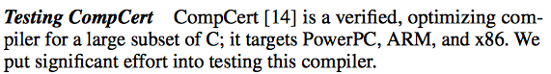
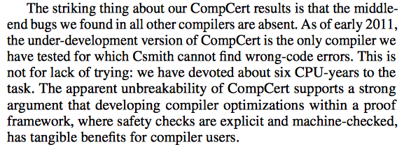
Why Verify One?
Compilers have bugs

Slide 10
Compiler Correctness
Abstractly, compiler C just a function that maps the syntax of source programs S to the syntax of target programs T:
C : S -> T, where
S = type of source programs (ASTs)
T = type of target programs (ASTs)
int main
(void) { … }
S
push %ebp
%eax <- %ebp + 1
T

Slide 11
Compiler Correctness
Compiler Correctness #1:
C is correct when
for every source program s : S
C(s) exhibits the same behavior as s
(assuming compilation succeeds)
Program Behaviors:
Terminate with value 3
Silently infinite loop
Infinite loop printing the infinite sequence 3, 3, 3, 3, 3, …
Crash immediately
Crash after printing 3, 3, 3
int main
(void) { … }
push %ebp
%eax <- %ebp + 1

Slide 12
Example Behaviors
What behavior does the following program exhibit?
> Print “-1\n”, Return 1
#include <stdio.h>
int foo (void) {
signed char x = 255;
printf("%d\n", x);
unsigned char y = 255;
return y > x;
}
int main(void) {
return foo();
}

Slide 13
Example Behaviors
Order of evaluation of function arguments unspecified in C
What about the following?
> clang-700.1.81: “ Hello World 7 7\n”
> gcc 4.9.2: “ World Hello 7 7\n”
#include <stdio.h>
int main(void) {
int i = 0;
return printf("%d %d\n",
printf(" Hello "),
printf(" World "));
}
The order of evaluation of the function designator, the actual arguments, and subexpressions within the actual arguments is unspecified, but there is a sequence point before the actual call.
C99 §6.5.2.2p10

Slide 14
Compiler Correctness Take 2
Compiler Correctness #1:
C is correct when
for every source program s : S
C(s) exhibits the same behavior as s
(assuming compilation succeeds)
int main
(void) { … }
push %ebp
%eax <- %ebp + 1

Slide 15
Compiler Correctness Take 2
Compiler Correctness #1:
C is correct when
for every source program s : S
C(s) exhibits the same behavior as s
(assuming compilation succeeds)
Compiler Correctness #2:
Compiler C is correct when
for every source program s : S
every behavior of the target C(s) is a possible behavior of source s
int main
(void) { … }
push %ebp
%eax <- %ebp + 1

Slide 16
Compiler Correctness Take 2
Compiler Correctness #2:
Compiler C is correct when
for every source program s : S
every behavior of the target C(s) is a possible behavior of source s
Behaviors of s
Behaviors of C(s)

Slide 17
Compiler Correctness Take 2
Compiler Correctness #2:
Compiler C is correct when
for every source program s : S
every behavior of the target C(s) is a possible behavior of source s
Allowed
behaviors
(E.g.,
must print
“3”, then
return 0)
Behaviors of s
Behaviors of C(s)

Slide 18
Recap
PART I: Overview
What’s a compiler? A verified compiler?
Why verify one?
What does it mean for a compiler to be correct?
PART II: Details
Specification details: Assigning meanings to programs
How do we actually prove correctness?
Scaling Up: A brief tour of CompCert

Slide 19
Assigning meanings to Programs

Slide 20
Assigning Behaviors to Programs
Operational Semantics
A key tool in the programming language practitioner’s toolbox
Basic idea:
Define a datatype to represent the syntax of programs (e.g., in C)
Define a model of the state of the system
Memory m, current command c, etc.
Define meaning (of programs in a particular language) as a transition, or step relation
g ⊢ c, m ⟹ c’, m’
Global environment
State before the step
State directly after

Slide 21
Example: Imp (“Imperative Language”)
Syntax
e ::= true | false | e1 && e2 | …
Expressions
c ::= skip
| if e then c1 else c2
| c1; c2
| while b do c
| print e
| …
Commands

Slide 22
Example: Imp (“Imperative Language”)
c,m ⟹ c’,m’
Semantics of commands
States m: sequences of printed values (e.g., [false, false, true, false, …])
If
⟦ e ⟧ = v //e evaluates to v
then
print e, m ⟹ skip, m `concat` [v]
print

Slide 23
Example: Imp (“Imperative Language”)
If
⟦ e ⟧ = true
then
if e then c1 else c2, m ⟹ c1, m
ITE-true

Slide 24
Example: Imp (“Imperative Language”)
If
c1, m ⟹ c1’, m’
then
c1;c2, m ⟹ c1’;c2, m’
sequence-1
skip;c2, m ⟹ c2, m
sequence-2

Slide 25
Example: Imp (“Imperative Language”)
while e do c, m ⟹
if e then (c; while e do c) else skip, m
while

Slide 26
Example
while true do print false, []
⟹ if true then
print false; (while true do print false)
else skip, [] (by the rule for while)
⟹ print false; (while true do print false), []
(by ITE-true)
⟹ skip; (while true do print false), [false]
(by rules sequence-1 and print)
⟹ while true do print false, [false]
(by rule sequence-2)
…

Slide 27
Expression Evaluation
Semantics of expressions (directly evaluated)
⟦ . ⟧ : expressions -> values
⟦ true ⟧ = true
⟦ false ⟧ = false
⟦ e1 && e2 ⟧ =
match ⟦ e1 ⟧, ⟦ e2 ⟧ with
| false, false => false
| false, true => false
| true, false => false
| true, true => true
true, false

Slide 28
Proof

Slide 29
Example: Constant Propagation
if true then
if false then
while true do
if e then print false
else print true
else print false
else print true

Slide 30
Example: Constant Propagation
if true then
if false then
while true do
if e then print false
else print true
else print false
else print true
print false

Slide 31
Constant Propagation Algorithm
Operative Rules
C[ if true then c1 else c2 ] = C[c1]
C[ if false then c1 else c2 ] = C[c2]
Administrative (“Search”) Rules
C[ while e do c ] = while e do C[c]
C[ c1; c2 ] = C[c1]; C[c2]
C[ c ] = c otherwise
[true, false, …]
sequences
printed by c
Want to prove …
Sequences printed by C[c]

Slide 32
Simulation
Key idea:
To prove that the behaviors of program t are a subset of those of program s,
it’s sufficient to show that any execution of t (starting, say, from an initial state)
can be matched by an analogous execution of s.
(Technically, a “backward simulation”)
∃
s,m_{s} ⟹ … ⟹ s′,m_{s}′ ⟹ s″,m_{s}″
Source
Source
“match” relation
R
R
R
∀
t,m_{t} ⟹ t′,m_{t}′ ⟹ t″,m_{t}″
Target

Slide 33
Example: Constant Propagation
Matching States
R(c,m_{s}, d,m_{t}) =
c~d
⋀ m_{s}=m_{t}
Matching Commands
if true then c1 else c2 ~ d1, c1~d1
if false then c1 else c2 ~ d2, c2~d2
while e do c ~ while e do d, c~d
print e ~ print e, always
…

Slide 34
Scaling Up

Slide 35
Scaling Up
To go from Imp to a compiler for a real language:
Scale up the semantics
to a real source language (e.g., C) and a real target language (e.g., x86), or even multiple target languages
Scale up the compiler
not just to translate from C -> assembly, but also to optimize!
common subexpression elimination, tailcall elimination, constant propagation, and more
this means many compilation phases, across multiple intermediate representations
Scale up the proof engineering
to develop libraries encapsulating common functionality

Slide 36
CompCert Phases
2016: Many more!

Slide 37
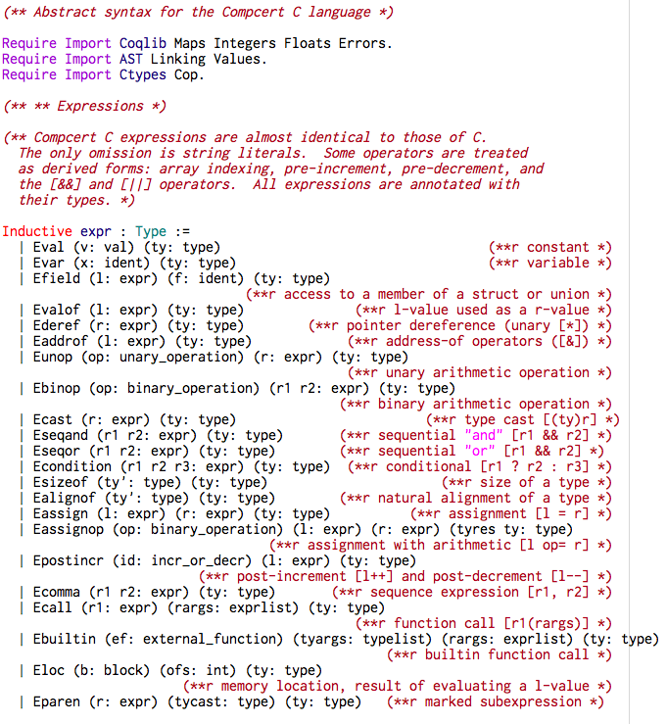
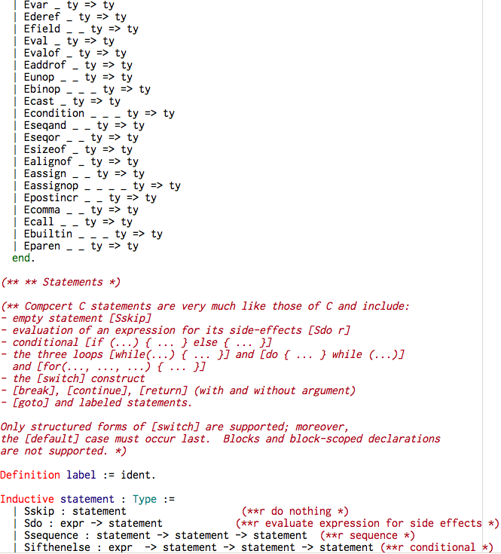
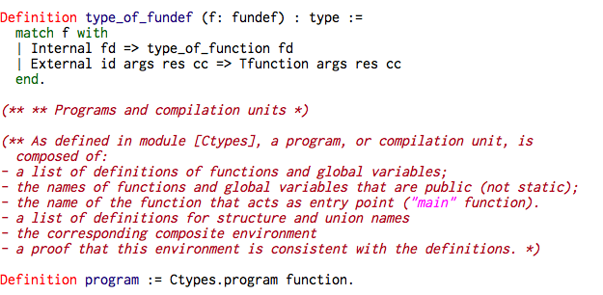
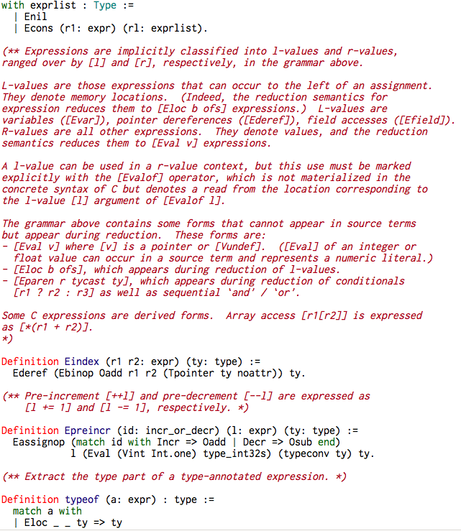
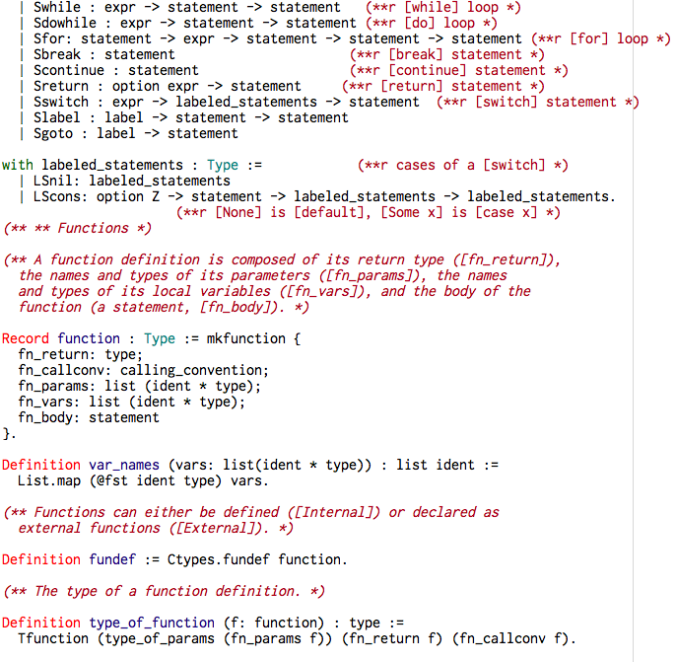
CompCert C Syntax

Slide 38
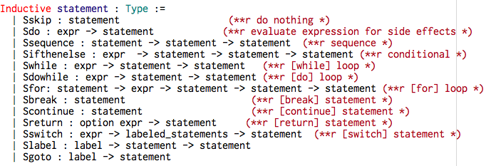
CompCert C Statements

Slide 39
CompCert Stats
Gordons-MacBook-Air:CompCert-2.7 gstewart$ coqwc */*.v
spec/defn proof comments
23 0 8 arm/Archi.v
230 493 267 arm/Asm.v
679 0 47 arm/Asmgen.v
221 596 69 arm/Asmgenproof.v
… many more lines …
57 74 27 powerpc/CombineOpproof.v
171 251 24 powerpc/ConstpropOpproof.v
136 163 62 powerpc/Conventions1.v
195 8 17 powerpc/Machregs.v
103 45 1 powerpc/NeedOp.v
592 299 145 powerpc/Op.v
251 639 35 powerpc/SelectOpproof.v
41 55 29 powerpc/Stacklayout.v
130 28 1 powerpc/ValueAOp.v
14 0 4 powerpc/extractionMachdep.v
53017 51600 10994 total

Slide 40
Research Directions
Extending the specifications/proofs of CompCert-scale compilers to support concurrency, separate compilation: [Beringer et al., ESOP’14], [Stewart et al., POPL’15], [Kang et al., POPL’16]
Formal verification of compilers for new languages or classes of languages:

Slide 41
More Information
Even talks can be mechanized!
GitHub: https://github.com/gstew5/acm-talk-sep2017
My website: http://ace.cs.ohio.edu/~gstewart/
Office: Stocker 355
OH: M/Th 11am-12pm
Thanks!

Slide 42
Need to verify conditions like…
∃
If
d1, m ⟹ d1′, m′
and (by IH)
c1, m ⟹ … ⟹ c1′, m′
then
if true then c1 else c2, m ⟹ … ⟹
c1′, m′
c,m_{s} ⟹…⟹ c′,m_{s}′
R
R
∀
d,m_{t} ⟹ d′,m_{t}′

